Slide 1
Attributes for Geotechnical Engineers
David Beadman

Slide 2

Attributes
Knowledge and Understanding of Engineering
Technical and Practical Application of Engineering
Management and Leadership
Independent Judgement and Responsibility
Commercial Ability
Health, Safety and Welfare
Sustainable Development
Interpersonal Skills and Communication
Professional Commitment
Notes:
ICE 3001A contains the attributes. Here is the list. Your Reviewers are obliged to check you for every one.

Slide 3

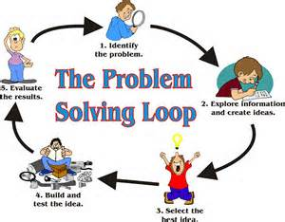
Why Engineering?
Enjoy solving problems
Notes:
Firstly why are we all Engineers and why are you seeking recognition of your Engineering ability by attending CPR. We all enjoy solving problems and all the better if someone agrees to pay us to solve their problems. Chartered status confirms our ability to solve problems with the regulatory and technical framework that we operate.

Slide 4
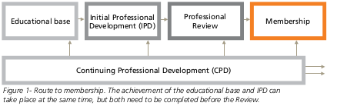
Purpose of Initial Professional Development (IPD)
Demonstrate achievement of Attributes at Professional Review

Slide 5
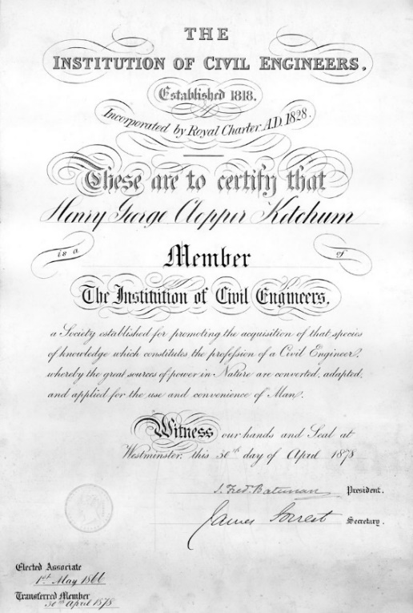

Graduate to Chartered Engineer
IPD

Slide 6
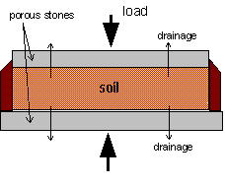
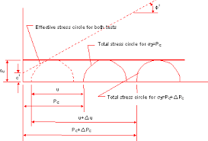
1. Knowledge and Understanding of Engineering
Not just a list of projects
Evidence of understanding
Technical nuggets – geotechnical design
Ability to discuss principles
Notes:
For example pile, slope or retaining wall design
drained / undrained, effective stress and total stress, flotation,
Beware starting to draw Mohr’s circles unless you can explain what is going on.

Slide 7
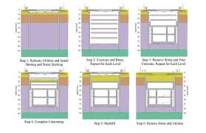
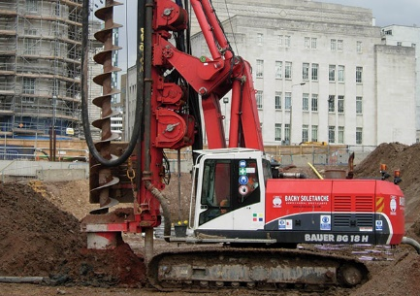
2. Technical and Practical Application of Engineering
Construction sequence
Construction (Piling etc.) methodology
Detailed design drawings
BIM
Notes:
Practical knowledge of how design is implemented. Limitations of equipment. Buildable construction sequence. Worst thing to present is a detailed design with no indication of how it can be built – i.e. temporary props with no removal sequence.

Slide 8
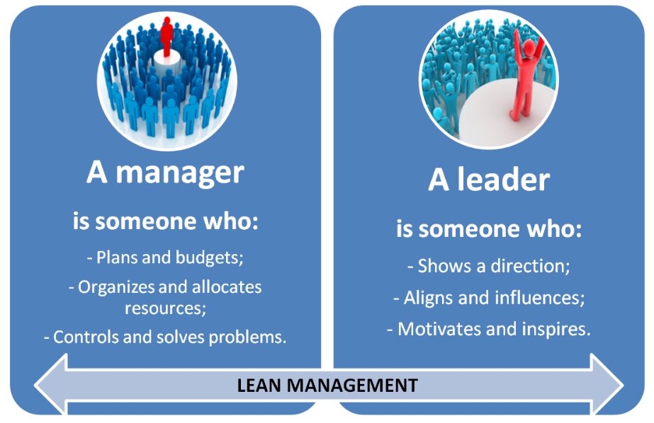
3. Management and Leadership
Difference between Management and Leadership
Consider your management style
Delegation
Notes:
Be prepared for questions about your management style, how you deal with new Graduates, draughtsmen, site operatives etc.

Slide 9

4. Independent Judgement and Responsibility
Difficult to give direct examples in your reports
Provide enough technical nuggets to demonstrate your understanding
Give an opinion when asked and defend your opinion
“Will this candidate make the right decision at some point in the future?
Notes:
It is difficult to demonstrate this attribute in writing – saying that you applied your judgement to a problem lacks conviction as a written text. Much better to demonstrate your understanding during the Review to give your Reviewers the confidence that you will make the right decision at some point in the future.

Slide 10
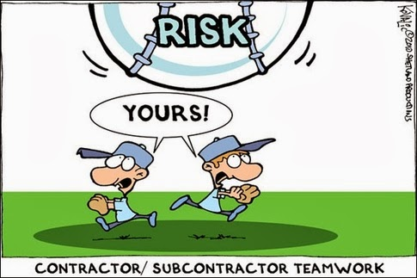
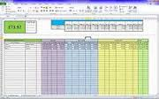
5. Commercial Ability
Contracting
Management of Sub-contractors
Consulting
Fees
Hourly rate
Notes:
Contracting – discuss allocation of risk. Consulting, most present a spreadsheet illustrating a fee calculation. Make sure you can discuss what is included in your hourly rate and not just say it is your salary.

Slide 11
6. Health, Safety and Welfare
Knowledge needed:
1974 Health and Safety at Work Act
Six-pack – 1992 etc.
Management of Health and Safety at Work Regulations 1999
Provision and Use of Work Equipment Regulations 1998
Manual Handling Operations Regulations 1992
Workplace (Health, Safety and Welfare) Regulations 1992
Personal Protective Equipment at Work Regulations 1992
Health and Safety (Display Screen Equipment) Regulations 1992
2015 Construction Design and Management (CDM) Regulations
Evidence of Risk Assessment experience
Notes:
Only attribute that must be demonstrated to pass at CPR, hence the red letters.

Slide 12
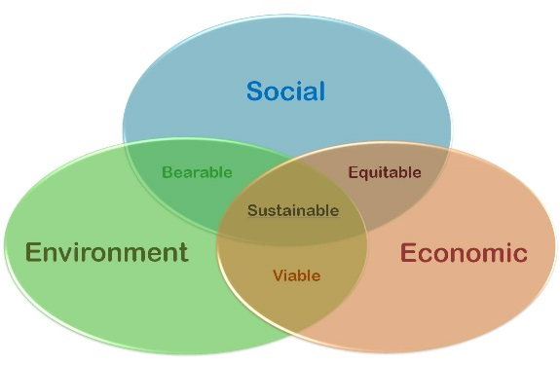
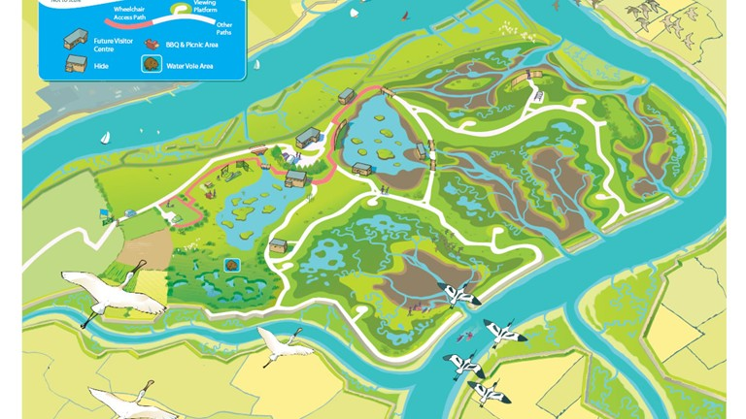
7. Sustainable Development
Awareness
Examples
Cost effective solutions
Reuse of materials (Crossrail – Wallasea Island)
  Reduce lorry movements
  Use water transport
‘Leading continuous improvement….’
Notes:
Often difficult to demonstrate experience of this attribute.

Slide 13

8. Interpersonal Skills and Communication
Demonstrated at Review
Discussion
Presentation
Reports
Manage diversity issues
Notes:
Largely the quality of your discussion with your Reviewers. Listen carefully to the question and take a few seconds to assess the question before stumbling into an answer.

Slide 14
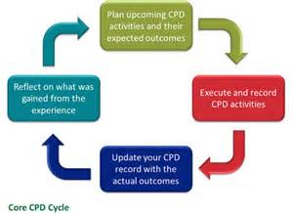
9. Professional Commitment
Attend ICE / BGA / BTS meetings
ICE Code of Conduct
Maintain CPD record
Membership of committee (i.e. BGA Young Persons Committee)
Stem Ambassador
Notes:
Often demonstrated in your CPD record. How do you plan to contribute to this Institution in the future?

Slide 15
BGA ECG
ICE CPR for Geotechnical Engineers
Review day tips and hints
Alison Graham

Slide 16
Review process
Summary
ICE Guidance
Planning
Initial Application
Discussion with Sponsors
Review document submission (Report plus Appendices, CV and CPD record)
Written Exercise Prep
Practice Review
Review Day
Presentation, Interview WE
Notes:
Brief overview of review process
7 sections
ICE guidance planning
Initial application
Discussion with your sponsors
Submission prep
WE prep
Practice review
Review day

Slide 17

ICE Guidance
    Step 1 Download and read ICE Guidance.
    Have a plan
    Set aside time to prepare application forms and submission documents
Notes:
Read guidance document read at start of planning
Useful check list
Start to put a plan together
Need to allow time for preparing application form and submission documents

Slide 18
Typical plan timeline
Action | Jan | Feb | Mar | Apr | May | Jun | Jul | Aug | Sept | Oct | Nov | Dec
Sign off by SCE and MDO
Contact Sponsors
First draft of report
CPR Application submission |  |  |  |  |  |  | 16th-20th
WE practice
Complete CPD and DAP
Finalise Report
First draft of Presentation
Practice review
Submission of documents
CPR Day |  |  |  |  |  |  |  |  | 24th-28th | 17th-18th
Results Day
Notes:
Example of plan for review in Autumn
Work backwards from application date, 16th to 20th July 2018
Leave good time to speak to SCE and MDO to get sign off
Also speak to Sponsors to give time for them to complete the questionnaire also needs to be submitted by the 20th July
Start prep for WE as soon as possible, even just collect useful bits of information
Notified of Interview date 4 weeks before hand
Submission 15 full working days before interview date
London reviews first 24th to 28th Sept, Cardiff last 17 to 18 Oct
This is an example but I would suggest that 6 months should be allowed

Slide 19

Initial Application
Meet with your regional MDO and SCE
    Sign off Training
    Will be busy as will have other potential candidates to see.
    Find out if they will be visiting your office or nearby office.
    Arrange meeting in good time (i.e. well before application deadline)
Add a photo of two/three people meeting
Notes:
First step to speak to MDO to get training signed off
Ensure fix a date early to give time as there will be others wanting to do the same
If they regularly visit your office do it then

Slide 20
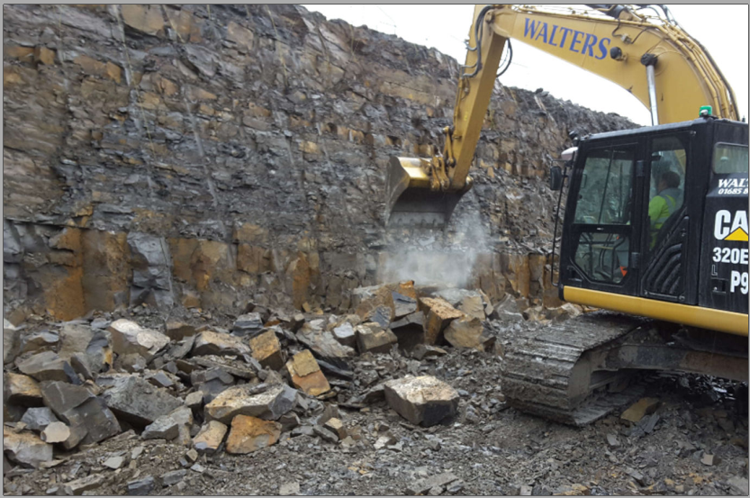
Discussion with Sponsors
Sponsors
    Lead Sponsor is typically your SCE
    Needs to shows this on sponsor form and sign 1 page summary
    Contact and have initial discussion with other 2 sponsors
    Again with sufficient time to allow them to complete the sponsor forms.
Photo from Rock cuts at A465
Notes:
Give Sponsors time to fill in sponsors questionnaires,
Lead Sponsor should be aware of your intentions
Will need to see at least 1 page summary but also useful to have first draft of your report, can then ensure responses on questionnaire relate to your examples.

Slide 21
Review Submission
Report
  How you have achieved the attributes. Note 5000 word limit
  What you did/decisions you made/your responsibilities
    Use pictures and diagrams, check what they show
    Check/review by others
  Your first point of contact with your reviewers.
    Use document to shine and impress your reviewers
    Poor documentation can give a wrong first impression
Notes:
Needs to pull out how your have achieved the attributes, as discussed in David’s presentation
Use figures and pictures to tell the story as well as words (helps with word count)
Get checked by Sponsors and peers, also useful to have anon-engineer to review to help with grammar and readability
First point of contact with reviewers will set the tone for the start of the review

Slide 22
Review Submission
Appendices
  Three A3 drawings – provide annotations/explanations. Use colour to add interest
  12 A4 sheets – think about what they show
    Hand calcs with sketches or simple spreadsheets again use annotation
    Show off your work.
  Show judgement, ground model, material parameter selection
  Type of analysis selected.
    Explain decisions you made
    Risk Assessments for design element
    EG’s Commendations/Programme for GI/claims process
Notes:
Ake the relevant to your report and the attributes
Use to show off your work, use annotation and extracts to help emphasis what you did
Has your name on it

Slide 23
Review Submission
  CV
  Additional to 5000 words, 2 pages
  Allows you to set the scene on projects i.e. value/your role and responsibilities. Show progression
  Use it wisely to add value to your submission
  CPD
  Records for min. of 3 years 30h/year. Show variety
    Include attendance at ICE/BGA/Geol Soc meetings (shows Professional commitment)
    Also include STEM/Voluteer work/Committees as well as training course
    Include DAP for at least current if not forthcoming year
Notes:
CV use it to show you off and give details on projects to save words in the main report text
CPD show variety of lectures/event attended ICE/BGA/Geol Soc meeting to show your commitment to the profession and ICE
Other areas of development such as STEM activities/Volunteering, RedR/commitees etc
Show how relates to DAP as well

Slide 24
Review Submission
Digital
1 PDF file <20MB
Maybe printed out
Electronic PDF rather scan
A4 sized except for drawings A3
Use reasonable font and text size
Use Hyperlinks to appendices and back
Notes:
Submission on15 working days before review date
Allows reviewers time to read and prepared for the review, also set WE questions relevant to your experience

Slide 25

Review Day - Preparation
    Mock Review
    Practice Presentation.
    Re read reports and appendices
    Visit venue beforehand
    Dress as you would to meet a client
    Arrive on time
    Relax
I
Notes:
Preparation
Saying 6 p’s Prior Planning and preparation prevents poor performance
Mock review
Practice presentation
Re read submission
Visit venue or at least check the location on mapping i.e Google
Arrive 30 minutes before hand to check in
Try and relax
Reviewers will try to put you at ease as a relaxed candidate is easier to interview

Slide 26

Review Day - Presentation
    How you will present (laptop or flip chart
    Approx. 8 to 10 slides, use pictures and diagrams
    Don’t regurgitate your report
    Keep to time
    Shows off your communication & Interpersonal skills
Photo of someone presenting
Notes:
Think about how you will present,
Laptop, check it is full charged, bring a back up in case of electronics failure
Needs to add to your report, further develop a theme area of your report
Sure way to annoy reviewers is to just repeat what they have already read about
Keep to time, the reviewers will be timing you too
First face to face interfacae with your reviewers
You are in control use it

Slide 27

Review Day - Interview
    Start with questions on your presentation
    Will lead on to questions arising from your report and any attributes not fully demonstrated
    Will cover all attributes
    Process is audited and consistent
    May ask what you would do differently
Notes:
Questions that follow on from your presentation, may ask you to flip back to slides to get more information on an aspect
Then questions that have arisen as the report has been read
Will cover all attributes
May have a auditor sitting in, he/she is there to audit the reviewers not you
Be prepared to give your opinion and defend it
Reviewers want you to be relaxed as possible and will ask a few questions to put you at ease.

Slide 28

Review Day – Written Exercise
    2 questions set based on your report/sponsors questionnaires, you answer 1
    Good first draft
    Laptop or hand written
    Want to see your opinion, how your present an argument and use evidence to back up
    Only 2 sides of notes now allowed
Image of some-one in an exam
Notes:
Based on what you have told the reviewers in your 1 page summary and report
Good first draft
Again looking for your opinion and how you present the your argument and use evidence to demonstrate points made.
Now only 2 sides of notes allowed.
Plagiarism is not allowed

Slide 29
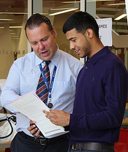
Results
    Reviewers will make a decision on the day
    Evidence to back up decision made submitted for review and audit
    Results sent Dec or June depending on when you sit
    Appeal???
Image of getting results
Notes:
Decision made on the day between the two reviewers
Then a detailed form is completed to back up the decision setting out the evidence provided for each attribute
Wil be audited and all failures will be reviewed
There is a appeal process but very few get upheld

Slide 30
GOOD LUCK
Any Questions

Slide 31
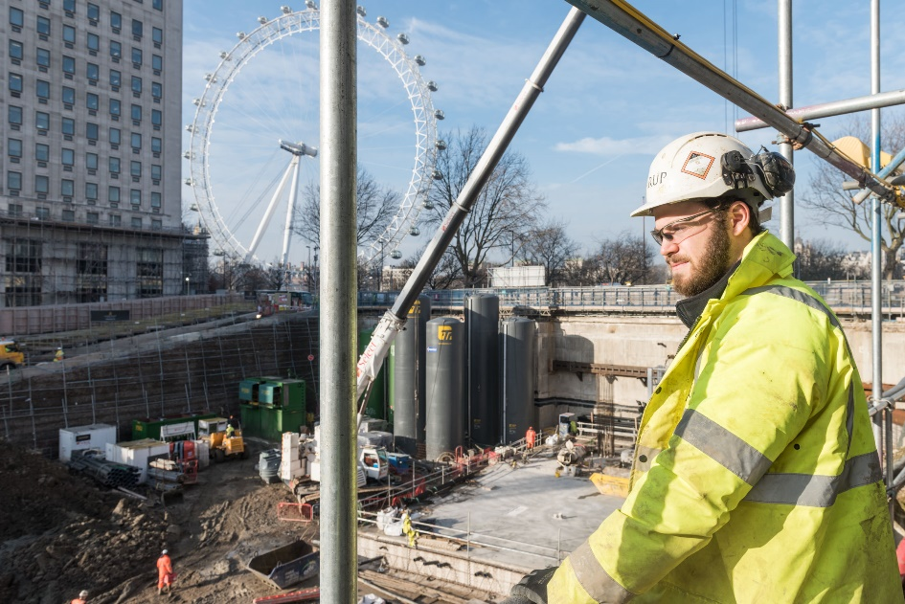
Chartered Professional Review Presentation
Thomas Beales Ferguson
Autumn 2017

Slide 32
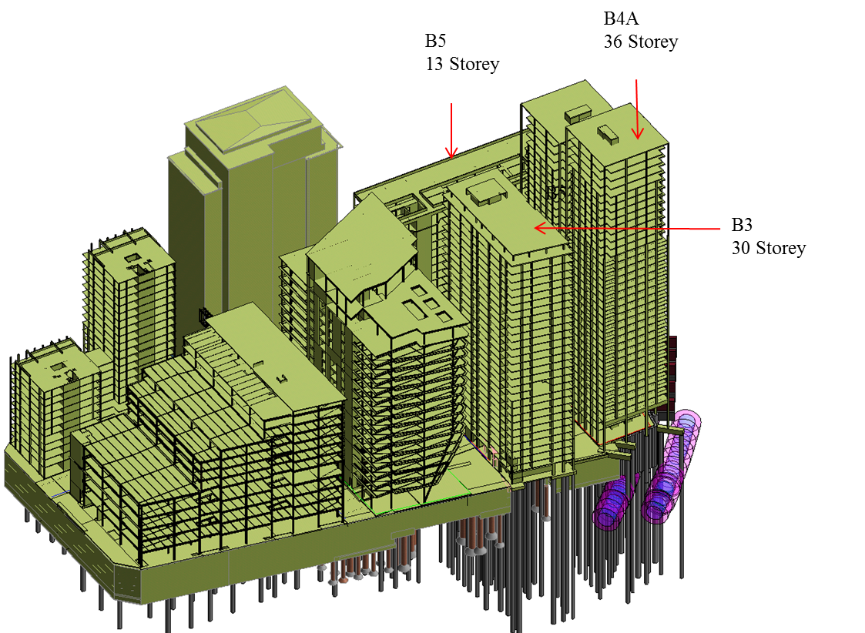
Contents
Site overview
Installing piles close to London Underground tunnels
Trials and monitoring
Health and safety incident
Northern Line

Slide 33
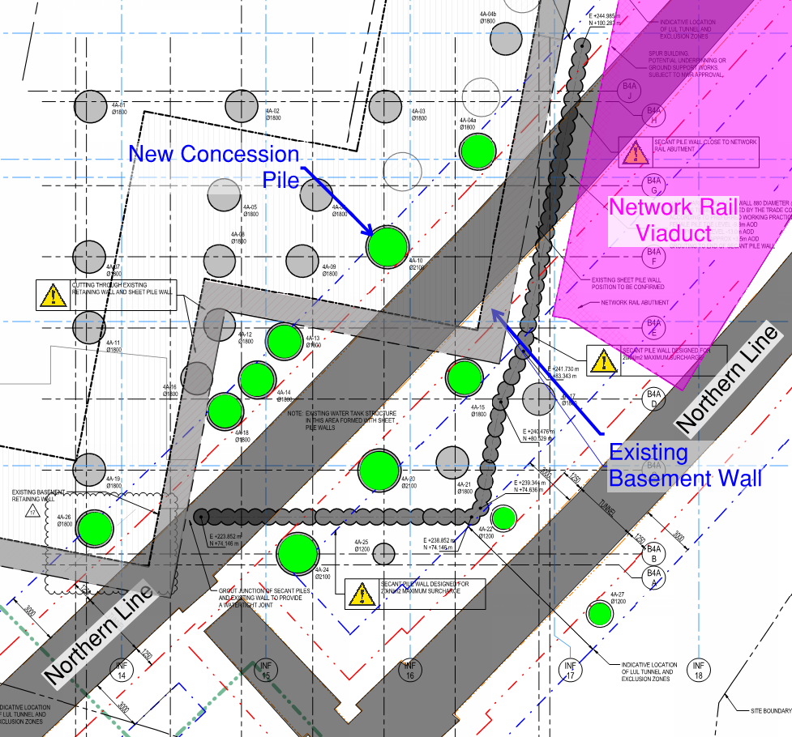
Concession Piles
Thanet Sand piles around Northern Line
Piles 1m from LUL
Concession required
~£70m additional floor space

Slide 34
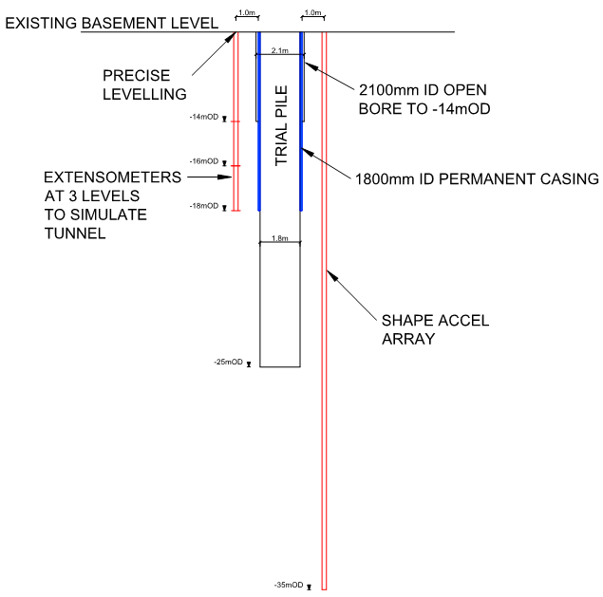
LUL Concession Trial Pile
Distant to LUL tunnel
Simulates installation methodology
Movement monitoring in boreholes

Slide 35
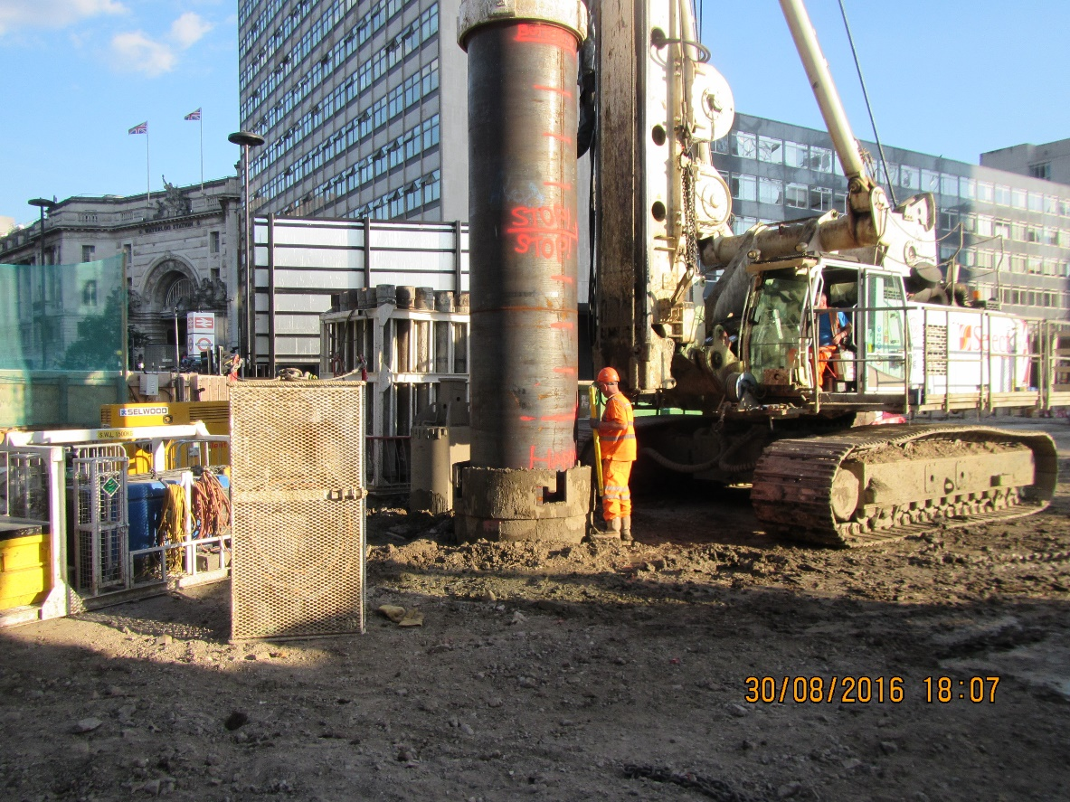
LUL Concession Piles

Slide 36
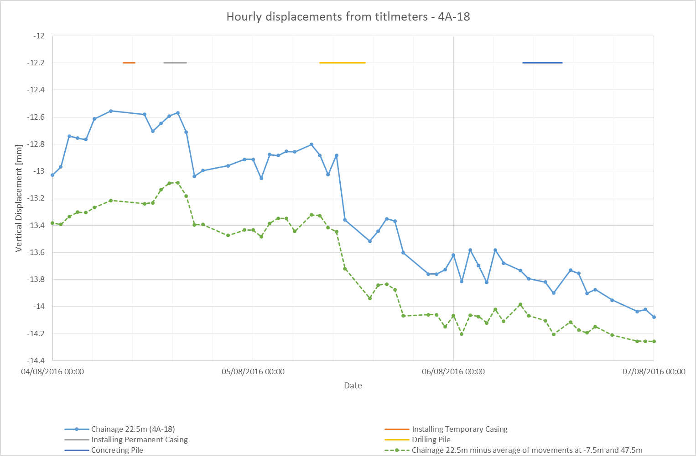
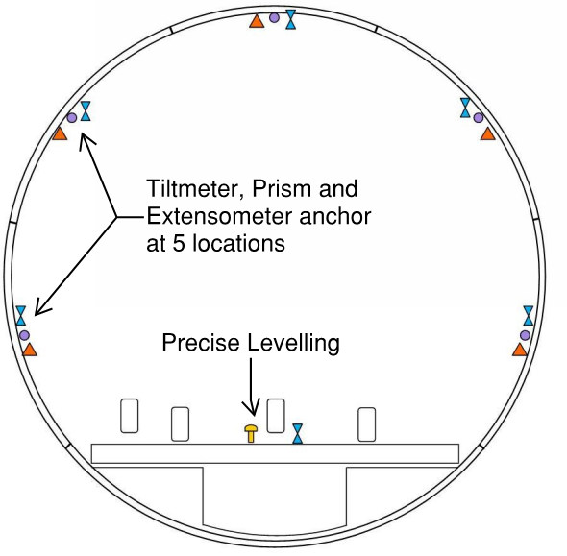
In-Tunnel Monitoring Analysis

Slide 37
Conclusion
My contribution
  Proved and developed a method to pile within 1m of running tunnels
  Gained trust of LUL
  Coordinated site activities where required
  Reviewed monitoring
Lessons learnt
  Deal fairly with people and good working relationships can be maintained even when things go wrong

Slide 38




Wednesday 21st February 2018
At ICE Westminster
Geotechnical and Geohazard challenges
for onshore and offshore pipelines
David Waring
BP Exploration Operating Company Ltd
and
Andy Mills
East Point Geo
Drinks after the event sponsored by
BP Exploration Operating Company Ltd

Slide 39

Future BGA Evening Meetings
(details on BGA Website)
Date | Title | Speaker | Bar Sponsor
28th February 2018 | 49th Cooling Prize Competition Papers competition for young ground engineers with a keynote lecture by Andrew Smith of Coffey on “A645 Newland Bridge: major repair works” | Hosted by the North West Geotechnical Group and ICE North West at The Friends Meeting House, 6 Mount Street, Manchester
7th March 2018 | Electrokinetic treatment of soils to enhance stability by accelerating consolidation - theory and recent projects | Professor Colin Jones and David Alder, Electrokinetic Limited | Electrokinetic Limited
21st March 2018 | 58th Rankine Lecture and Dinner at Imperial College Preceded by free half-day seminar at Imperial College | Dr Nick O’Riordan of Arup speaking on “Dynamic Soil Structure Inter-action”. Linking fabric, structure and soil behaviour: Recent advancements

Slide 40
    BGA 58th Rankine Lecture
    on Wednesday 21st March 2018 at 5.30 pm
    at
    Imperial College, London
    Dr Nick O’Riordan (Arup)
    on
    Dynamic soil-structure interaction

Slide 41

    Please join the BGA Early Careers Group for
    Post-Rankine lecture drinks
    @: H-Bar
    Imperial College London
    Sponsored by Aecom

Slide 42


Linking fabric, structure and soil behaviour:
Recent advancements
A free half day seminar at Imperial College London
1:00 – 4:30 pm on 21 March 2018,
followed by Rankine lecture at 5:30pm
ISSMGE Technical Committees:
TC 105 Geo-Mechanics from Micro to Macro
TC 101 Laboratory Testing

Slide 43

    Call for Abstracts for XVII European Conference on
    Soil Mechanics and Geotechnical Engineering, Reykjavik
    The conference will be held in Reykjavik, Iceland
    from 1 to 6 September 2019
    Deadline for abstracts is 15th April 2018
    Draft full papers due 30 October 2018
    Full details on the conference website https://www.ecsmge-2019.com

Slide 44
    Call for Nominations to Stand for Election for the BGA Executive Committee
    The committee will hold elections for three vacancies
    Full details and nomination Forms available via the BGA website
    Deadline for nominations 16th April 2018
    Results of election will be announced at BGA AGM
    on 19th June 2018

Slide 45

Please join us for drinks
sponsored by
Mott MacDonald

